Slide 1
Healthcare Analysis
Lucky Suman

Slide 2
Business Understanding & Overview
We have a data set containing patient data along with the appointment details. We will use Exploratory Data Analysis in order to get actionable insights convert them into meaningful stories and present them so that the clinic can take necessary actions to reduce the no-show at medical appointments.

Slide 3
Understanding the data

Slide 4
Target Variable
No-show patients: 22319
Patients who were present at appointments: 88208
So 20% is the absence rate and 80% is the presence rate.
We have to analyze all the features with respect to absence rate and presence rate to get some insights to find who were no-show patients.

Slide 5
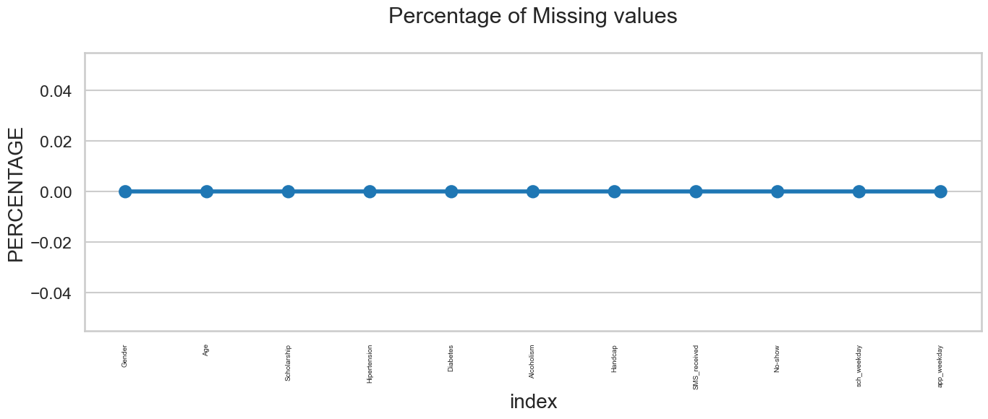
Initial Intuition and Missing Data
There is no missing value in the data

Slide 6
Negative value of Age
In this data, we can see that the minimum number of age is 1 but we know that age can not be negative. We can see that only one record has an age of -1 which can be dropped.
count | 110527
mean | 37.088874
std | 23.110205
min | -1
25% | 18
50% | 37
75% | 55
max | 115

Slide 7
Categorical Analysis

Slide 8
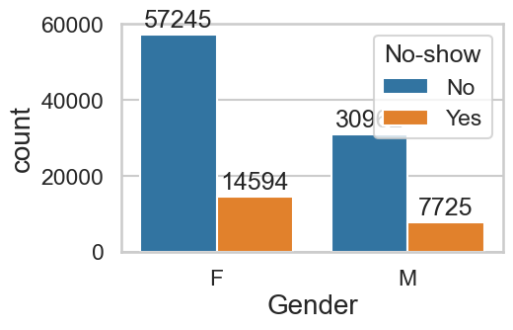
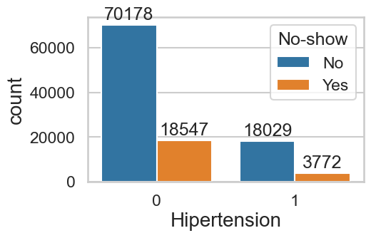
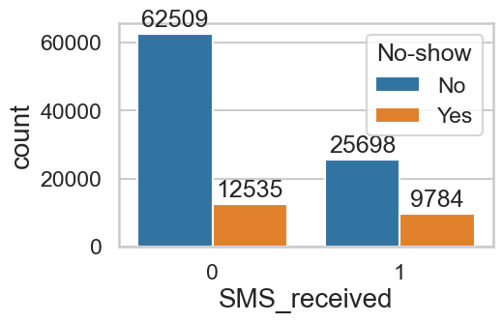
Univariate Analysis
There are very less appointments on Saturdays and no appointments on Sundays.
More than 83% of patients with hypertension problems have visited at the time of appointment.
Patients who are enrolled in the scholarship were high absentees with an absent rate of 23%. 80% of patients who are not enrolled in scholarship have visited at the time of appointment.
Females have more appointments than males.
Patients who received messages were high absentees.
Patients with high disabilities were high absentees at appointments.
Patients aged between 0 to 28 years were high absentees at appointments with a 23% absence rate.
More than 85% of Patients aged between 58 - 86 years were present at appointments.
People having appointments on Saturdays were high absentees with an absence rate of 23%.
More than 82% of patients with diabetes problems have visited at the time of appointment.
80% of Patients with very little disability have visited at the time of appointment

Slide 9
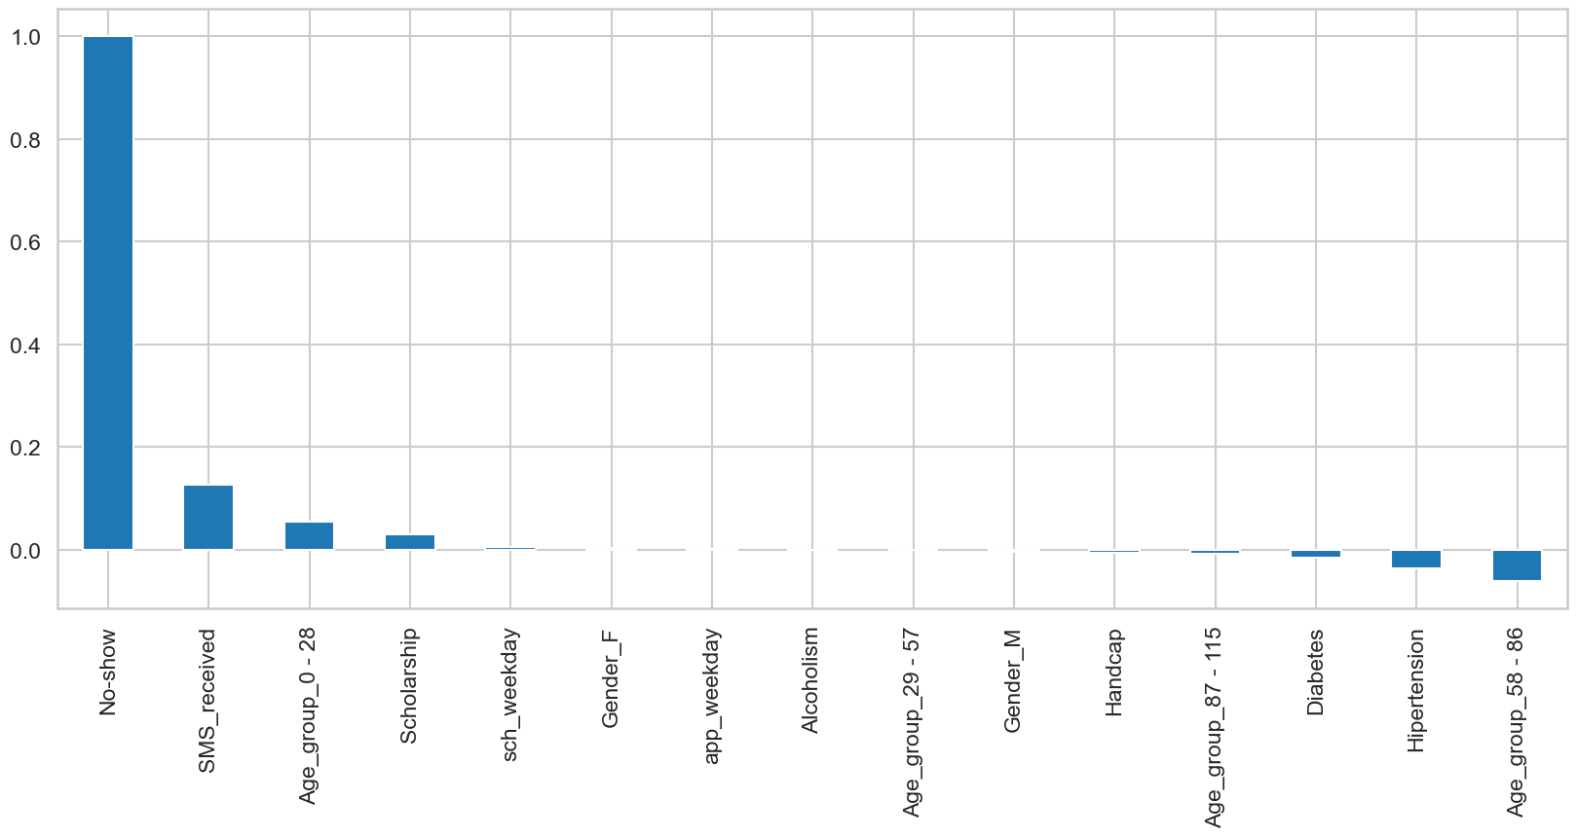
Correlation of no-show with all the features

Slide 10
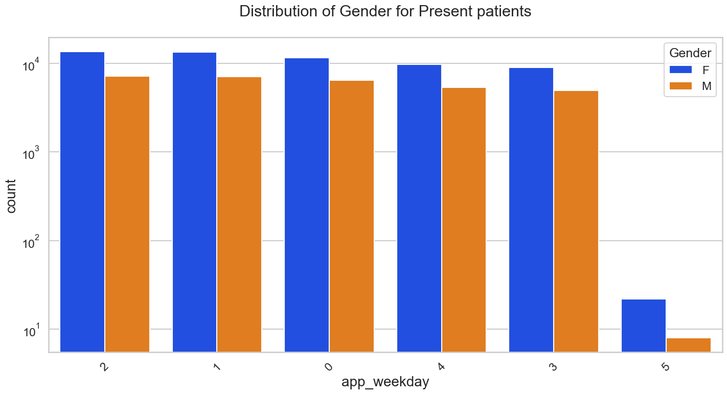
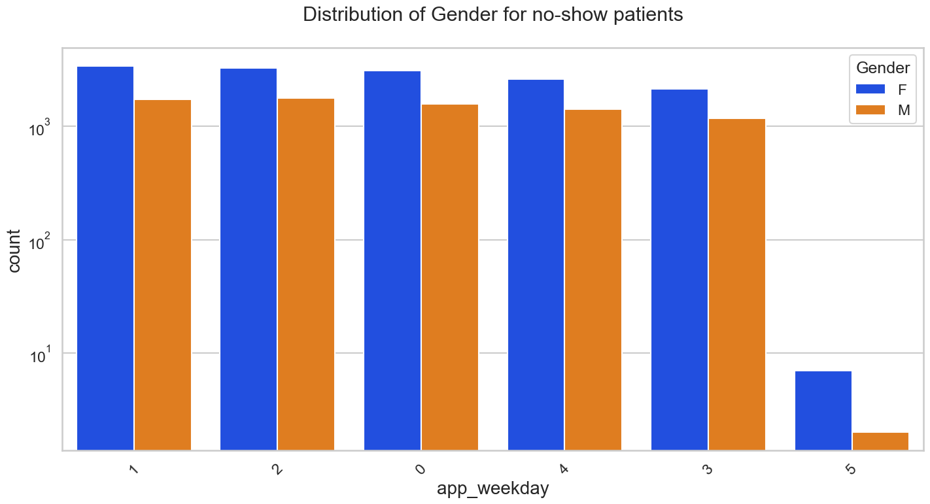
Bi-variate Analysis
Females have more appointments than males

Slide 11
Final Thoughts
There are very less appointments on Saturdays and no appointments on Sundays.
More than 83% of patients with hypertension problems have visited at the time of appointment.
Patients who are enrolled in the scholarship were high absentees with an absent rate of 23%. 80% of patients who are not enrolled in scholarship have visited at the time of appointment.
Females have more appointments than males.
Patients who received messages were high absentees.
Patients with high disabilities were high absentees at appointments.
Patients aged between 0 to 28 years were high absentees at appointments with a 23% absence rate.
More than 85% of Patients aged between 58 - 86 years were present at appointments.
People having appointments on Saturdays were high absentees with an absence rate of 23%.
More than 82% of patients with diabetes problems have visited at the time of appointment.
80% of Patients with very little disability have visited at the time of appointment

Slide 12
Thank you

